Slide 1
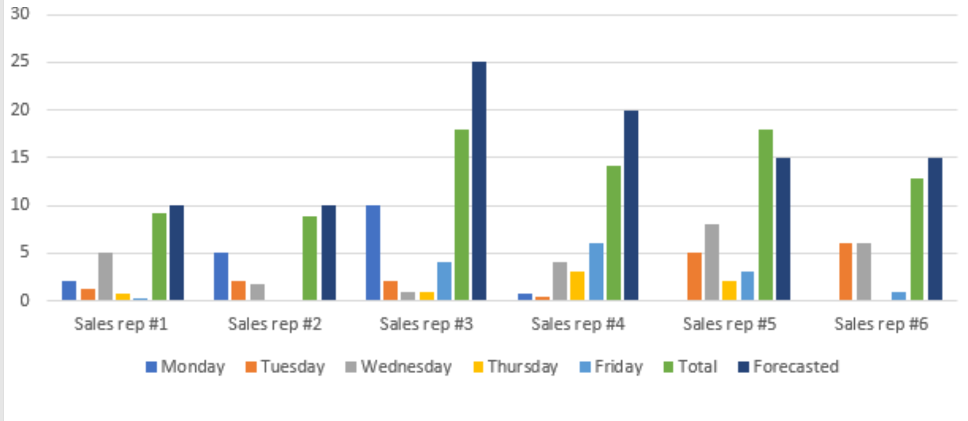
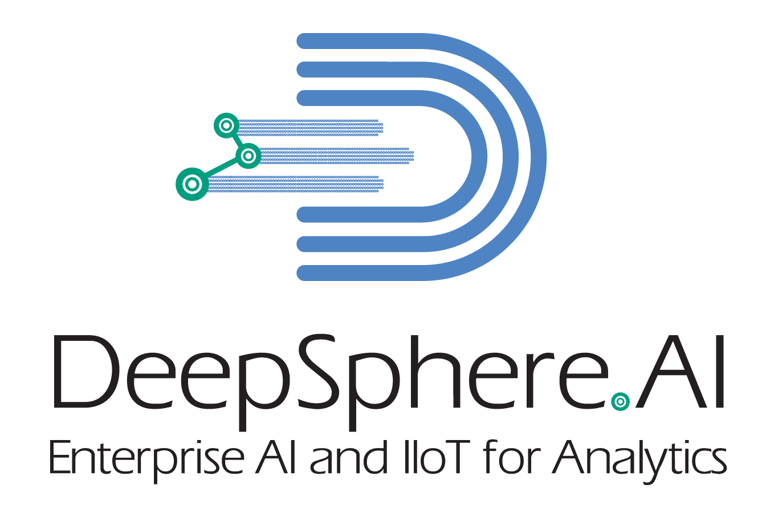
Module One: Introduction to Data Analytics
Data Analytics Defined
Business Insights and Decision Making
In the business context, data analytics is a practice in an organization with governance, methodology, and processes to collect, analyze and extract insights on data for business and business shareholders.
Data visualization and reporting
Extract Insights on data
Prepare and analyze data
Collect data from various sources
Business Challenges and Needs
USA | Singapore
Jothi Periasamy | Jperiasamy@ucdavis.edu | 916-296-0228
©DeepSphereAI.SG 2021 | Confidential & Proprietary

Slide 2
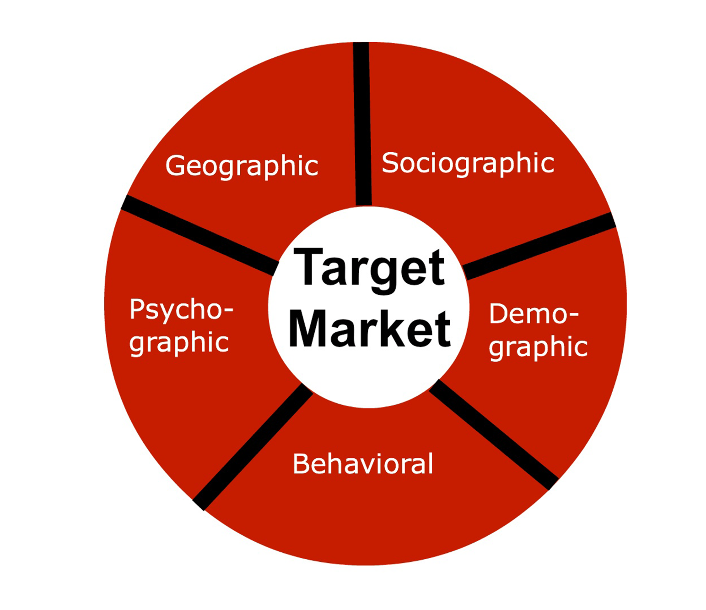
Module One: Introduction to Data Analytics
Data Analytics: Real-world Example
Target marketing (where, whom, and when)
Potential Promotions
Target marketing: Identify the potential customers who are going to buy a particular product
Reporting
Potential customer
Potential products
Customer profile
Product profile
Customer demographic data
Customer purchase history data
Consumer spending data
Target marketing: Identify the potential customers who are going to buy a particular product
USA | Singapore
Jothi Periasamy | Jperiasamy@ucdavis.edu | 916-296-0228
©DeepSphereAI.SG 2021 | Confidential & Proprietary

Slide 3
Module One: Introduction to Data Analytics
Data Analytics: Key Challenges
What are the challenges we may encounter in data analytics projects
Skilled resources
Skilled resources
Business alignment
Formalizing project scope
Business cases and business benefits
Working with various data sets
Data governance and data management
Accuracy and Timeliness
Meeting stakeholders expectation
Across the globe, the number one challenge in data analytics is cross-functional skilled resources.
Cross-functional: Business, data, analytics, and technologies
USA | Singapore
©DeepSphereAI.SG 2021 | Confidential & Proprietary

Slide 4
Module One: Introduction to Data Analytics
Industry Trends and Market Demand
Data Analytics Trends
1
2
3
4
5
Reporting
Analytics
Advanced Analytics
Data Science
GEN AI/LLM
Structured and formatted information
Actionable insights
Data driven decision
Machine intelligence
There is no code and No SQL
Deal with Raw Data
Changes in Data Analytics
USA | Singapore
©DeepSphereAI.SG 2021 | Confidential & Proprietary

Slide 5
Module One: Introduction to Data Analytics
Industry Trends and Market Demand
Insights
4
Prescriptive
3
How can we make it happen?
Foresight
2
Predictive
Information
What will happen?
Measurable Values
1
Foresight
Diagnostic
Why did it happened?
Descriptive
Insight
What Happened?
Hindsight
Business Challenges
USA | Singapore
©DeepSphereAI.SG 2021 | Confidential & Proprietary

Slide 6
Module One: Introduction to Data Analytics
Industry Trends and Market Demand
Real-World Examples
Descriptive
What Happened?
The COVID19 death rates increased by 7% compared to last week
Note: Add Date
Diagnostic
Why did it happen?
The new COVID 19 variant and daily vaccination rates are causing to increase the death rates
Predictive
What will happen?
In the current state of vaccination rate, the death rate will reach 12% in two weeks from now
Prescriptive
How can we make it happen?
Create a recommendation for easy access to the COVID19 vaccination at any time and anywhere
USA | Singapore
©DeepSphereAI.SG 2021 | Confidential & Proprietary

Slide 7
Module One: Introduction to Data Analytics
Data-Driven Decision Making
Data-Driven Decision Making (DDDM) is a management process for making business decisions confidently, accurately, and timely. DDDM enables businesses to analyze data, extract insights and use the insights as facts to make a business decision.
For example, a retail company like Raley's wanted to open a new location in and around UC Davis. They need insights to take some critical decisions, when, where, and how to open the new site.
Let's say the HR department at Kaiser wanted to hire RN (registered nurses), and they need a decision point on the headcount and the experience level(entry-level, mid-level, senior-level) for each Sacramento location and the
Data
Information
Insights
Decisions
USA | Singapore
©DeepSphereAI.SG 2021 | Confidential & Proprietary

Slide 8
Module One: Introduction to Data Analytics
Data-Driven Decision Making
What is Data-Driven Decision Making: Explain with some Real-world examples
USA | Singapore
©DeepSphereAI.SG 2021 | Confidential & Proprietary

Slide 9
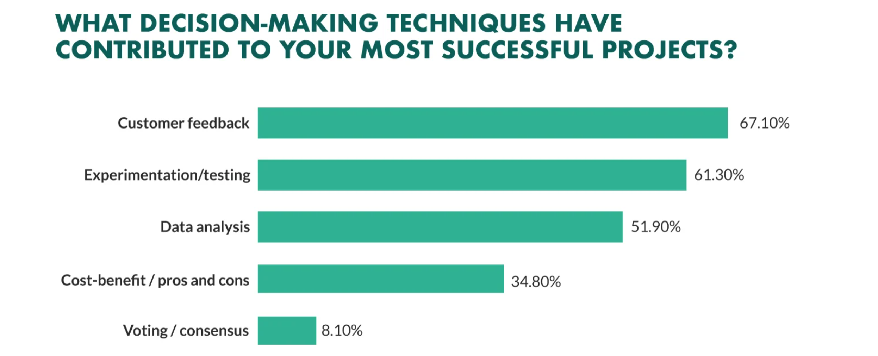
Module One: Introduction to Data Analytics
Data-driven Decision Making: Reading and Researching
Why do we need DDDM
Who needs DDDM
Benefits of DDDM
Challenges in DDDM
Key functions of DDDM
DDDM vs. None DDDM
What business decisions can I use DDDM
In-Class Group Discussion
USA | Singapore
Jothi Periasamy | Jperiasamy@ucdavis.edu | 916-296-0228
©DeepSphereAI.SG 2021 | Confidential & Proprietary

Slide 10
Module One: Introduction to Data Analytics
Data Analytics Advancement
The industry is leading towards artificial intelligence, machine learning, and data science. Also, businesses are expected to go beyond structure data to use unstructured data, semi-structured data, machine data, sensor data, and sensor data.
AI
Artificial
Intelligence
Data
Science
Big
Data
IIoT
Industrial Internet of things
Machine
Learning
USA | Singapore
©DeepSphereAI.SG 2021 | Confidential & Proprietary

Slide 11

Module One: Introduction to Data Analytics
Data Analytics Advancement: Reading and Researching:
Big Data
IIoT ( Industrial Internet of Things)
Artificial Intelligence (AI)
Machine Learning (ML)
In-Class Group Discussion
USA | Singapore
©DeepSphereAI.SG 2021 | Confidential & Proprietary

Slide 12
Module One: Introduction to Data Analytics
Data Management vs. Data Engineering
What is Data Engineering: Explain with some Real-world examples
USA | Singapore
©DeepSphereAI.SG 2021 | Confidential & Proprietary

Slide 13
Module One: Introduction to Data Analytics
Data Management vs. Data Engineering
Data
Collection
Data
Mapping
Master Data Management
Traditional Data Solutions
Data Preparation
Data
Enrichment
Data
Governance
Data
Conversion
Data
Profiling
Data
Quality
Data Transformation
Data
Catalog
Data
Management
USA | Singapore
©DeepSphereAI.SG 2021 | Confidential & Proprietary

Slide 14
Module One: Introduction to Data Analytics
Data Management vs. Data Engineering
Challenges in Traditional Data Solutions
Hardcoded business rules
Physical data movements
Redundant/duplicate data storage
Challenging to adopt business changes
Time Consuming and Manual work
High Cost and High Labor
Inefficient approach
Limited options to work with unstructured, semi structured, and other data's like images, voices, videos, and streaming data
USA | Singapore
©DeepSphereAI.SG 2021 | Confidential & Proprietary

Slide 15
Module One: Introduction to Data Analytics
Data Management vs. Data Engineering
Challenges in Traditional Data Solutions
Data Engineering
Hardcoded business rules
Physical data movements
Redundant/duplicate data storage
Challenging to adopt business changes
Time Consuming and Manual work
High Cost and High Labor
Inefficient approach
Limited options to work with unstructured, semi structured, and other data's like images, voices, videos, and streaming data
Data Engineering aims to address all these challenges and redefines the data traditional data management processes
USA | Singapore
©DeepSphereAI.SG 2021 | Confidential & Proprietary

